Slide 1
Assignment 3
You will be completing many of the same questions as in Assignment 2 using MatLab rather than python
So, you should be able to focus on the MatLab syntax because the logic of what you need to do will be nearly identical
Class time will be available December 6 and during the final period for this course, Monday December 10, 1-3 PM
The assignment is due Friday, 11:59 PM, December 14
You will create a MatLab script assignment3_LASTNAME_uXXXXXXX.m
You will turn in both the code and output from running the code (assignment3_LASTNAME_uXXXXXXX.pdf) to both Brian and John via Slack
If you needed to makeup missing the trip to the Utah Data Center, complete the assignment and send via slack by Wednesday, 11:59 PM, December 12

Slide 2
Question 1: Find max and min with loop
The purpose of this question is to demonstrate your knowledge of how loops, conditional statements, and variable assignments work.
Write a loop that finds and prints the maximum and minimum number in a list of random numbers WITHOUT USING BUILT-IN MAX or MIN FUNCTIONS
This should require:
Generate a row vector ‘a’ of 100 uniformly distributed random numbers between 0 and 100 (this is slightly different from Assignment 2 and you will create floating values between 0 and 100 )
Use a loop with nested if statements to find the maximum and the minimum values of the row vector
Use a variable to store max value, amax
Create a variable to store min value, amin
Write out the min and max values using fprintf in a format similar to (your numbers will be different): min and max values are: 0.19 97.46
Verify your results by including code to check your answers using the max and min functions in MatLab (this is something not required in Assignment 2), assign those to the variable bmax and bmin, and print those out.

Slide 3
Question 2: Great Salt Lake Level
Observed levels of the Great Salt Lake have been recorded since 1896 and are available in the file data/gsl_yr.csv.
The first column is the year, the second column is the number of observations used to calculate the average lake level, and the third column is the average lake level for that year in feet.
Load the data into a 2d array gsl using the csvread function and complete and answer the following:
Plot a line graph of the data.
x axis is year
y axis is lake level in meters
Apply appropriate axis labels and add a title
What was the highest lake level and what year did that occur? Add a blue star to the plot to indicate the year and level. (note: use the max function to return both the max value and the vector index of the max value)
What was the lowest lake level and what year did that occur? Add a red star to the plot to indicate the year and level.
What is the average lake level? Draw a black line from the first year to the last year in order to show the average lake level on the figure (hints: you need to define a 2-element vector with the first and last year and another 2-element vector repeating the average value. Also, limit the plotting area to the start and end years)
How many years during the period of record were the lake levels above average and print that number out using fprintf (use the function find and then determine the length of the vector returned from find)

Slide 4
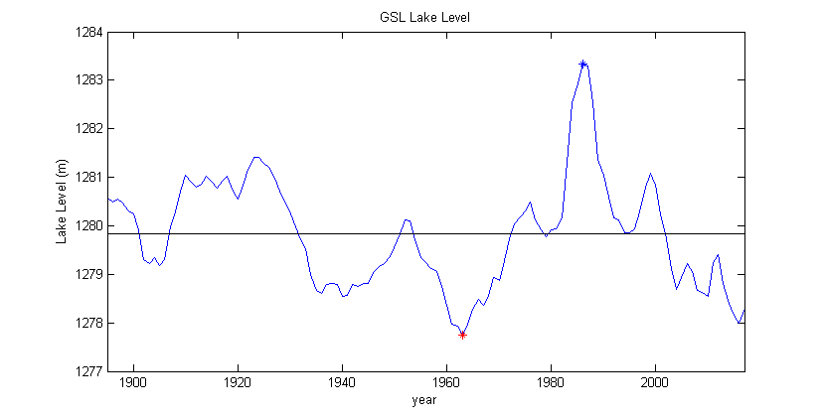
Your result should look like

Slide 5
Question 3: Wind chill
The apparent air temperature changes with wind speed, also known as wind chill,follows where the temperature is given in degrees Fahrenheit and the wind speed is given in miles per hour.
Compute the wind chill for all integer Celsius temperatures between [-40, 10] and all integer wind speeds between [1, 40].
Create a row vector for temperatures (temp) and row vector for wind speeds (speed)
Use meshgrid to create 2D arrays of temperatures and speeds (tm and sm) in metric units
Convert tm to array tf in F and array sm to sp in mph
Perform elementwise array math to compute wind chill using the above equation (will be a 2D array, wcf)
Convert wcf to wind chill wc in Celsius
Generate a filled, contour image of wc as a function of tm and sm . Use the winter colormap and contour at 5 C intervals from -70 to 5C. Add a colorbar
Add appropriate labels and a title
Check that the results makes sense and answer the following.
Does the wind chill temperature decrease with increasing wind speed?
Does the wind chill for a given temperature change more for a change in wind from 1-20 MPH or from 61-70 MPH?

Slide 6
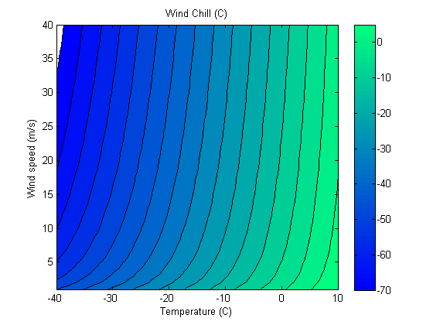
Your result should look like

Slide 7
Question 4: Multiple plots & indexing
Compute the lake level anomalies relative to the 1981-2010 mean (common to use the most-recent 30-year period)
Find the index values for yr 1981 and 2010 and then compute the mean (mean_30y) for that 30-year period only
Compute the anomalies of the lake level every year from that 30-yr mean
Create a two-panel plot as shown on the next page where the lower plot is identical to that in Figure 1.
The upper panel shows the lake level anomalies relative to the 1981-2010 mean

Slide 8
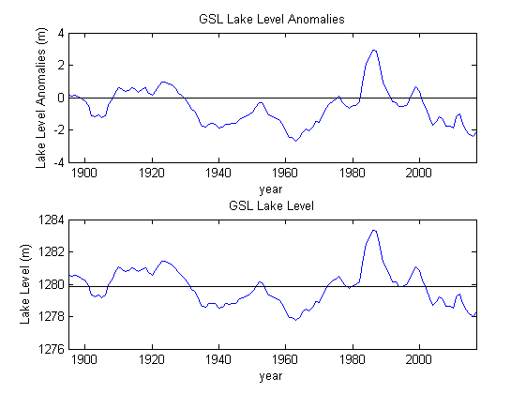
Your result should look like

Slide 9
LAST STEP: Publish your results
Go to publish
Go to Edit Publishing Options
Change output file format to pdf
Select Publish
Your code should run. Check that all the figures are correctly embedded
Submit your code and pdf to Brian and John via Slack

